Slide 1
How To Train Your Deep Multi Object Tracking ​
Pallavi Pamulapati 2020101095​
Aishwaryabharathi 2020102060​
Shriya Dullur 2020102006​
Keerthi Pothalaraju 2020102010​

Slide 2
CONTENTS
OBJECTIVE
MOTIVATION
DATA COLLECTION
CLEARMOT
DEEPMOT

Slide 3
MOTIVATION
Deep learning can be used to train the multi- object tracking. Existing methods train only certain sub-modules using loss functions. Which do not often correlate with the evaluation metrics – MOTA and MOTP
As these measures are non-differentiable, we cannot directly use them to optimize the loss functions. Hence, this paper proposes DeepMOT.​
A differential framework of Deep Hungarian Network is introduced which provides the approximation of the Standard Hungarian Algorithm used for getting the optimal predicted-to-Ground truth assignment.
DeepMOT is a framework to train multi-object trackers including the DeepMOT Loss that directly co-relates with the established tracking evaluation metrics.

Slide 4
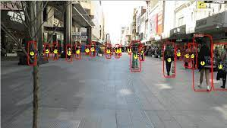
DATASET
- Evaluating and comparing multi-target tracking methods is not trivial. One main reason for this is the ground truth, i.e., the perfect solution one aims to achieve, is difficult to define clearly.
- As the video may contain cropped targets, reflections in mirrors or windows, and objects that very closely resemble targets all impose intrinsic ambiguities, such that even humans may not agree on one ideal solution.
- Lack of pre-defined test and training data makes it difficult to compare different methods fairly.
- We have used the MOT16 dataset in our project, which is a total of 233Mb

Slide 5
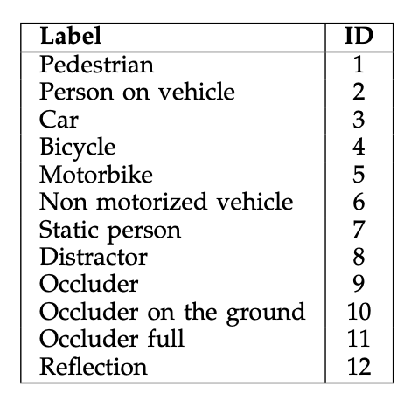
MOT 16
- MOTChallenge benchmark datasets are released to provide a fair comparison between tracking methods. In these MOT16 benchmark is used to evaluate the tracking methods (ClearMot and DeepMot).
- MOT16 contains a set of sequences with more crowded scenarios, different viewpoints, camera motions, and weather conditions. And also, the annotations for all sequences are double-checked by researchers to ensure highest annotation accuracy.
- Not only pedestrians but also vehicles, sitting people, and other significant object classes are annotated.
- We have also added some labels for the objects detected during preprocessing the dataset based on the annotation rules set by the MOT benchmark.

Slide 6
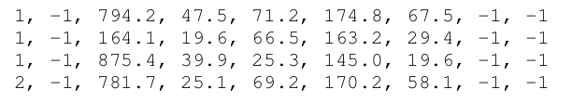
Data Format
- Each video in MOT16 contains 2 text files, one for public detections and another for ground truths. These files are simple comma-separated value (CSV) files
- Each line in the public detections file resents one object instance and contains 9 values as shown
- The first number indicates in which frame the object appears, while the second number identifies that object as belonging to a trajectory by assigning a unique ID (initially, set to -1). The Id is unique as each object can be assigned to only one trajectory
- The next four numbers indicate the position of the bounding box in 2D image coordinates. The position of the bounding box is indicated by the top-left corner as well as width and height of the box. And the next number denotes their confidence score. The last two numbers are ignored.

Slide 7
Data Format
- Similarly, for the ground truths file, the 7th value (confidence score) acts as a flag whether the entry is to be considered. If the value is 0 that instance can be ignored during the evaluation process.
- The 8th number indicates the type of the object (i.e., label of the object). And last number shows the visibility ratio of each bounding box

Slide 8
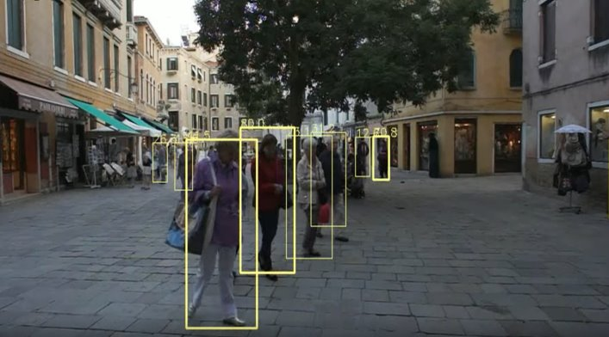
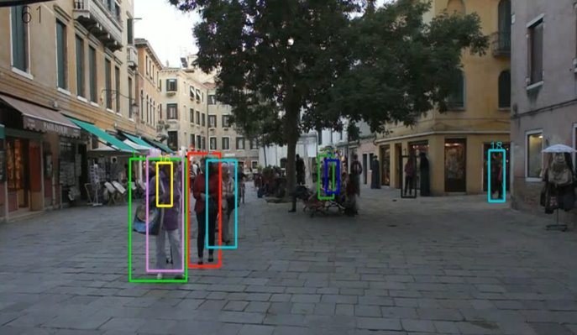
Public Detections / Tracks
Ground Truths

Slide 9
Predicting CLEARMOT measures

Slide 10
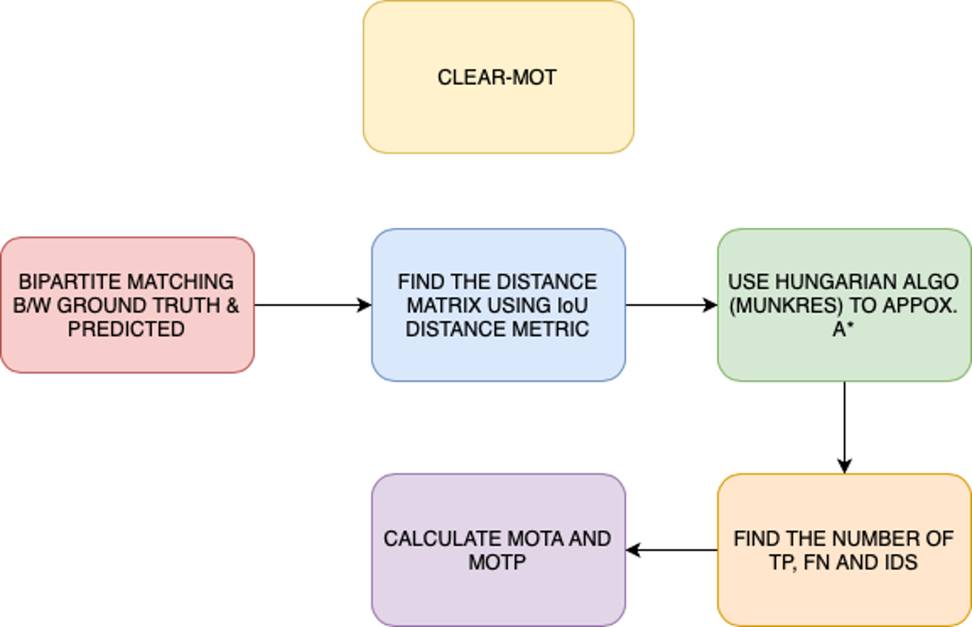

Slide 11
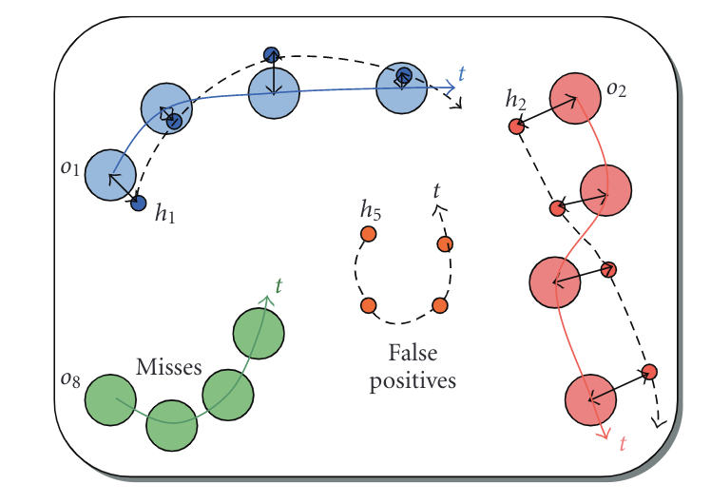
CLEARMOT – Finding Distance
The MOT’s main task is to accurately estimate the bounding boxes for the object instances in the time frames. Then, associate these predicted boxes with the ground truths, over each time frame to track the path of the object.
At a time-frame t, the predicted bounding boxes are compared with the ground-truth objects bounding boxes. These are compared using the Intersection Over-Union (IoU) distance metric and a distance matrix of size N*M is obtained. Where N is the number of bounding boxes(the rectangular boxes over every object) and M is the number of ground-truth objects in a time frame t.

Slide 12
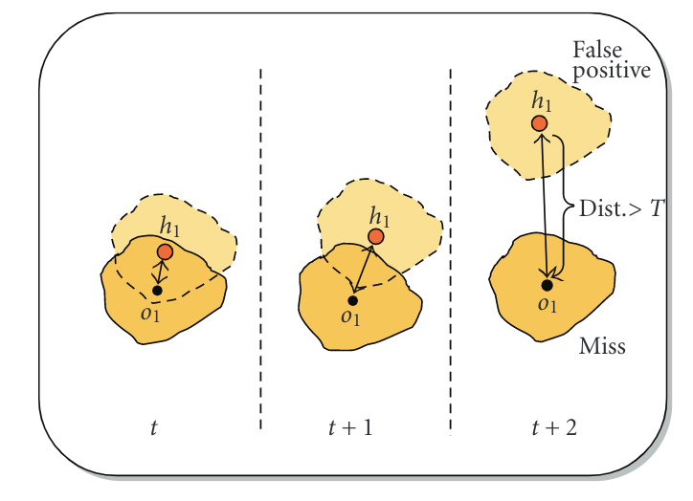
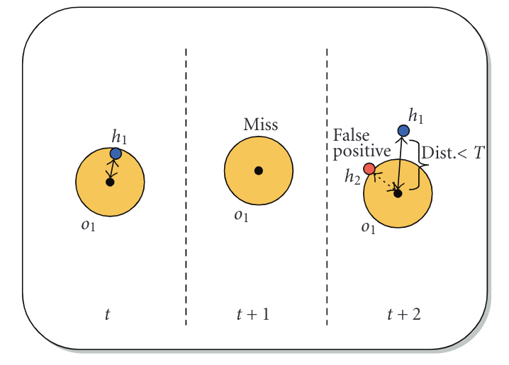
MOT Metrics
Optimal prediction to ground-truth assignment (a binary matrix) is obtained using the Hungarian Algorithm.
Then we calculate the accuracy and precision of the model using popular MOT metrics like MOTA and MOTP. These metrics depend on the False Positives, False Negatives, Association matrix obtained from the Hungarian Algorithm, and Identity Switches in a time frame t.

Slide 13
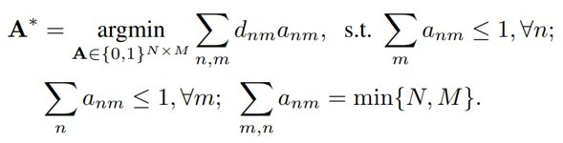

Hungarian Algorithm
Here A* is the optimal association between ground-truth objects and track predictions.
After computing A*, following evaluation measures are computed.
Multi-Object Tracking Accuracy
This uses False Positives, False Negatives and Identity Switches in time frame t to compute the accuracy

Slide 14
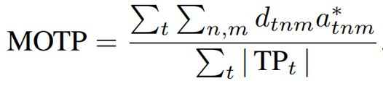
Multi-Object Tracking Precision
This averages the overlap between all correctly matches predictions and their ground truths in a time frame t.
These evaluation metrics are useful for optimization of tracker's hyperparameters.

Slide 15
Results - MOT16 Dataset
The results we obtained for MOT16 dataset
 | MOTA | MOTP
ClearMOT | 54.47 | 76.01
As these evaluation metrics are not differentiable, the gradient descent method cannot be used to optimize the tracker. So, we use DeepMOT with differentiable metrics

Slide 16
DEMO – Working ------>

Slide 17
Deep MOT
We formalize DHN with a non-linear mapping that inputs D and outputs the proxy soft assignment matrix A' .
DHN is modeled by a neural network A' = g(D, ω) with parameters ωd.
DHN produces a proxy A' that is differentiable with respect to D.
Importantly, the DHN mapping must satisfy several properties:
(i) the output A' must be a good approximation to the optimal assignment matrix A*
(ii) this approximation must be differentiable w.r.t. D
(iii) both input and output matrix are of equal, but varying size
(iv) g must take global decisions as the HA does.

Slide 18
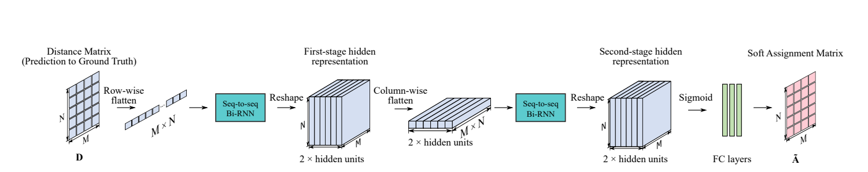
The proposed approximation is based on a bidirectional recurrent neural network (Bi-RNN) that computes the (soft) assignment matrix based on the prediction to-ground-truth distance matrix.
The row-wise flattened D is input to a first Bi-RNN that outputs the first-stage hidden representation of size N × M × 2h, where h is the size of the Bi-RNN hidden layers.
The first-stage hidden representation are flattened column-wise, to input to a second Bi-RNN that produces the second-stage hidden representation of size N × M × 2h.
we feed the second-stage hidden representation through three fully-connected layers. Finally, a sigmoid activation produces the optimal N × M soft assignment matrix A' .
Through DHN, the gradients from the approximated tracking performance measures are back-propagated to update the tracker weights.

Slide 19
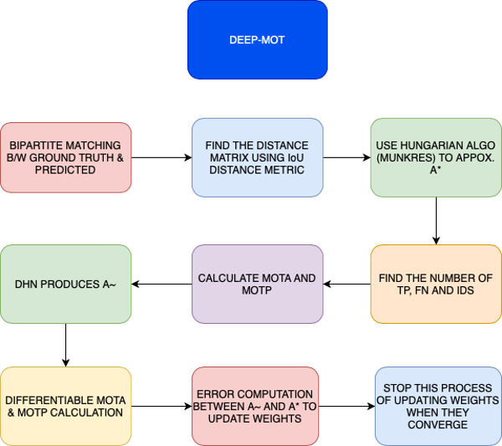

Slide 20
Differentiable MOTA and MOTP
To make MOTA and MOTP differentiable (I.e. dMOTA and dMOTP) we express FN, FP, IDS as functions of D and Ã.
To find soft approximations of FP and FN, we construct matrices Cr and Cc by appending a column and row to Ã respectively, filled with threshold value.
Next, we perform row-wise SoftMax and column-wise SoftMax. The resulting sum of elements in Crn,M+1 and CcN+1,m gives us the soft approximations of FP and FN respectively.
To compute soft approximations of IDS and MOTP, we construct two additional binary matrices BTP and B-1TP, whose non-zero entries represent true positives in the time frames t-1 and t respectively.
To get the number of ID switches we take a l1 norm of the matrix obtained by dot product of BTP and binary complement of B-1TP .

Slide 21



DIFFERENTIABLE LOSS FUNCTION
From the above calculations we get dMOTA and dMOTP as:
As we train our tracker to maximize MOTA and MOTP, the loss function can be
Where λ is the loss balancing factor

Slide 22
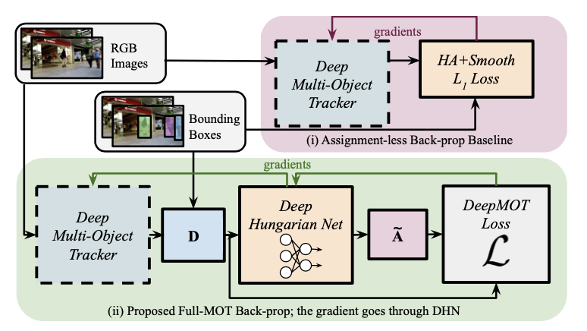
HOW TO TRAIN YOUR DEEP MULTI-OBJECT TRACKER
We can observe the overall tracker procedure in this diagram:
Given a video sequence, a pair of consecutive frames will be taken. Initialize the tracks with the ground truth boxes in time frame t and run the forward pass to obtain predicted bounding boxes.

Slide 23

We then compute the distance matrix D and use our proposed DHN to compute A~
We compute loss based on D and A~
This provides us the gradient that accounts for the assignment, and that is used to update the weights of the tracker.
DHN TRAINING:
A dataset is created with matrices D and A* seperated into training and test sets. The matrix D is the distance matrix which is found by comparing the ground-truth and predicted bounding boxes.
We can evaluate the performance of DHN by computing weighted accuracy (WA):

Slide 24
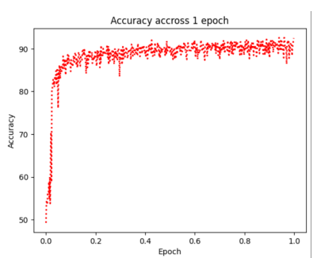
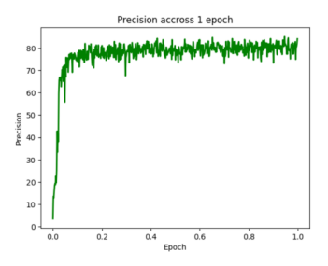
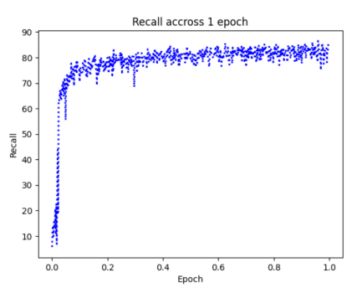

Slide 25
WWork Distribution
Data collection - Pallavi, Shriya
ClearMOT model – Aishwarya, Shriya, Pallavi
DHN model – Keerthi, Aishwarya, Shriya
Metric calculation and comparison – Pallavi, Aishwarya, Keerthi
Report and Readme – Pallavi, Shriya, Keerthi

Slide 26
THANKYOU

